Slide 1
Datacenters
CS353
Alefiya Hussain

Slide 2
What you need to know
Characteristics of a datacenter environment
goals, constraints, workloads, etc.
How and why DC networks are different (vs. WAN)
e.g., latency, geo, autonomy, …
How traditional solutions fare in this environment
e.g., IP, Ethernet, TCP, ARP, DHCP
Specific design approaches we cover in class

Slide 3
Disclaimer
Material is emerging (not established) wisdom
Material is incomplete
many details on how and why datacenter networks operate aren’t public

Slide 4
Plan
Today
Characteristics and goals of datacenter networks
Focus on differences relative to the Internet
Explore
Emerging solutions

Slide 5
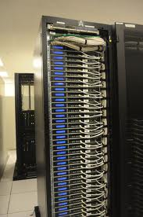
What goes into a datacenter (network)?
Servers organized in racks

Slide 6
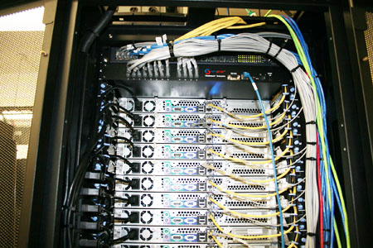
What goes into a datacenter (network)?
Servers organized in racks
Each rack has a `Top of Rack’ (ToR) switch

Slide 7
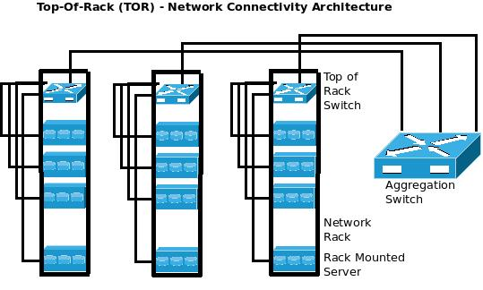
What goes into a datacenter (network)?
Servers organized in racks
Each rack has a `Top of Rack’ (ToR) switch
`Aggregation switches interconnect ToR switches

Slide 8
What goes into a datacenter (network)?
Servers organized in racks
Each rack has a `Top of Rack’ (ToR) switch
`Aggregation switches interconnect ToR switches
Connected to the outside via `core’ switches
note: blurry line between aggregation and core
With 2x redundancy for fault-tolerance

Slide 9
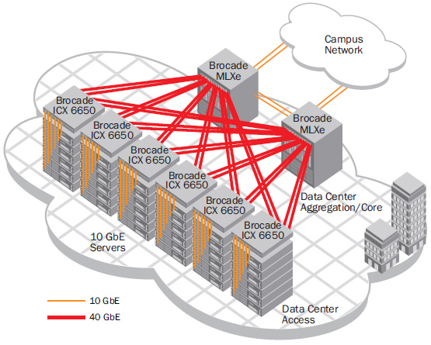
E.g., Brocade Reference Design

Slide 10
E.g., Cisco Reference Design
Internet
CR
CR
. . .
AR
AR
AR
AR
S
S
S
S
S
S
. . .
A
A
…
A
A
A
…
A
~ 40-80 servers/rack

Slide 11

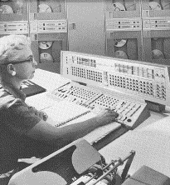
Datacenters have been around for a while
1961, Information Processing Center at the National Bank of Arizona

Slide 12
What’s new?

Slide 13
What’s new?
Scale
Applications
Large-scale computations (“big data”)
Customer-facing, revenue generating services
Service model
Clouds (jargon: SaaS, PaaS, DaaS, IaaS, …)
Multi-tenancy

Slide 14
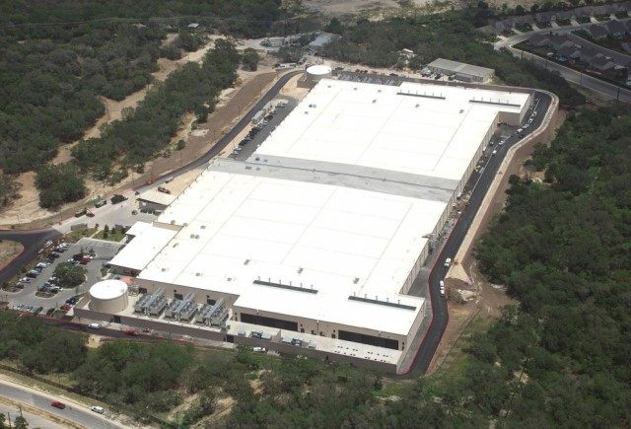
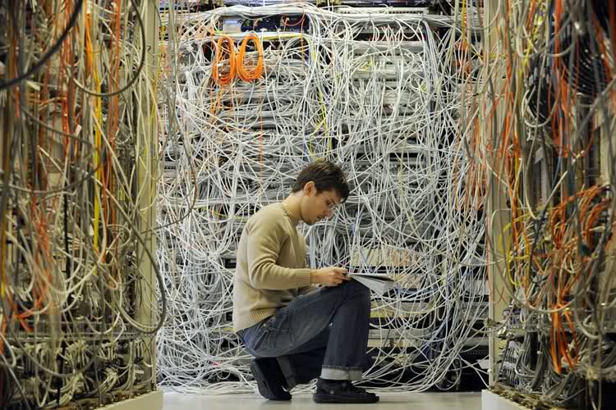
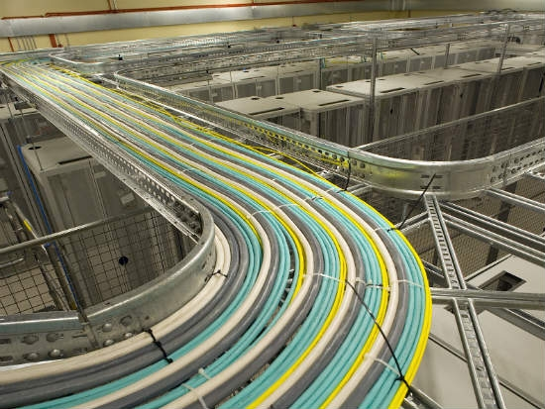
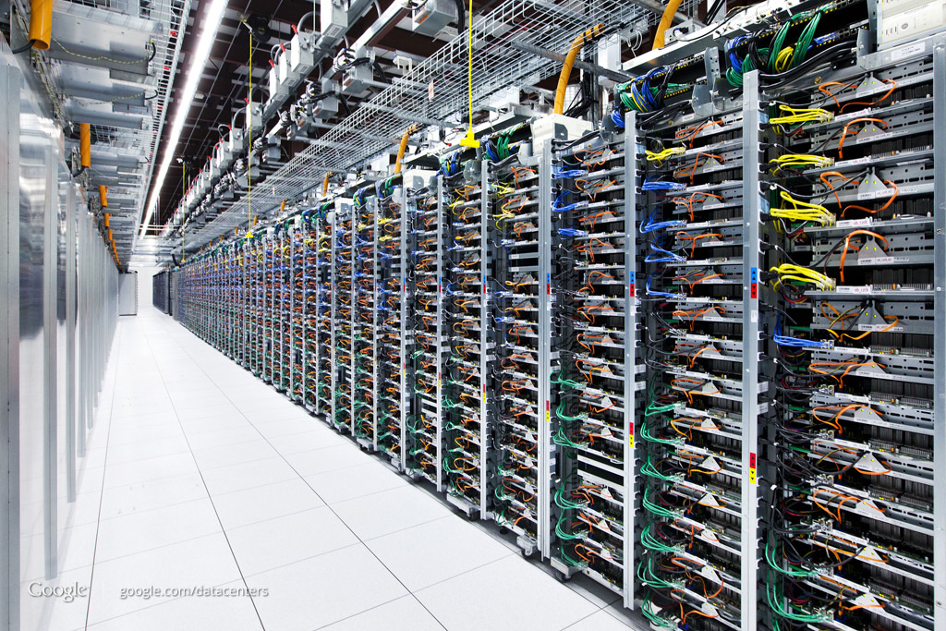
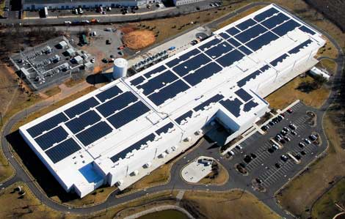
SCALE!

Slide 15
How big exactly?
1M servers/site [Microsoft/Amazon/Google]
> $1B to build one site [Facebook]
>$20M/month/site operational costs [Microsoft ’09]
But only O(10-100) sites

Slide 16
Implications (1)
Scale
Need scalable designs (duh): e.g., avoid flooding
Low cost designs: e.g., use commodity technology
High utilization (efficiency): e.g., >80% avg. utilization
Contrast: avg. utilization on Internet links often ~30%
Tolerate frequent failure
Large number of (low cost) components
Automate

Slide 17
Implications (2)
Service model: clouds / multi-tenancy
performance guarantees
isolation guarantees
portability
Network Virtualization – SDN

Slide 18
Applications
Common theme: parallelism
Applications decomposed into tasks
Running in parallel on different machines
Two common paradigms
“Partition Aggregate”
Map Reduce

Slide 19
Partition-Aggregate
user requests from the Internet
Router / Load Balancer
Front-End
Proxy
Front-End
Proxy
Web Server
Web Server
Web Server
Data
Cache
Data
Cache
Database
Database

Slide 20
“North – South” Traffic
Interactive / query-response exchange between external clients and datacenter
Handled by front-end (web) servers, mid-tier application servers, and back-end databases

Slide 21
Map-Reduce
Distributed
Storage
Map
Tasks
Reduce
Tasks
Distributed
Storage

Slide 22
Map-Reduce
Often doesn’t cross the network
Some fraction (typically 2/3) crosses the network
Distributed
Storage
Map
Tasks
Reduce
Tasks
Distributed
Storage
Always goes over the network

Slide 23
“East-West” Traffic
CR
CR
AR
AR
AR
AR
S
S
S
S
S
S
S
S
. . .
S
S
S
S
A
A
…
A
A
A
…
A
A
A
…
A
A
A
…
A

Slide 24
“East-West” Traffic
Traffic between servers in the datacenter
Communication within “big data” computations
Traffic may shift on small timescales (< minutes)

Slide 25
Common traffic pattern: “Elephants” and “Mice”
Web search, data mining (Microsoft) [Alizadeh 2010]
<100KB
>10MB
55% of flows
3% of bytes
5% of flows
35% of bytes

Slide 26
Implications (3)
Applications
High bandwidth any-to-any communication (“bisection bandwidth”)
Low latency is critical
Worst-case (“tail”) latency is critical

Slide 27
High Bandwidth
Ideal: Each server can talk to any other server at its full access link rate
Conceptually: DC network as one giant switch

Slide 28

DC Network: Just a Giant Switch!
H1
H2
H3
H4
H5
H6
H7
H8
H9

Slide 29
DC Network: Just a Giant Switch!
H1
H1
H1
H2
H2
H2
H3
H3
H3
H4
H4
H4
H5
H5
H5
H6
H6
H6
H7
H7
H7
H8
H8
H8
H9
TX
H9
H9
RX

Slide 30
DC Network: Just a Giant Switch!
H1
H1
H2
H2
H3
H3
H4
H4
H5
H5
H6
H6
H7
H7
H8
H8
TX
H9
H9
RX

Slide 31
High Bandwidth
Ideal: Each server can talk to any other server at its full access link rate
Conceptually: DC network as one giant switch
Would require a 10 Pbits/sec switch!
1M ports (one port/server)
10Gbps per port
Practical approach: build a network of switches (“fabric”) with high “bisection bandwidth”
Each switch has practical #ports and link speeds

Slide 32
Bisection Bandwidth
Partition a network into two equal parts
Minimum bandwidth between the partitions is the bisection bandwidth
Full bisection bandwidth: bisection bandwidth in an N node network is N/2 times the bandwidth of a single link
→nodes of any two halves can communicate at full speed with each other.

Slide 33
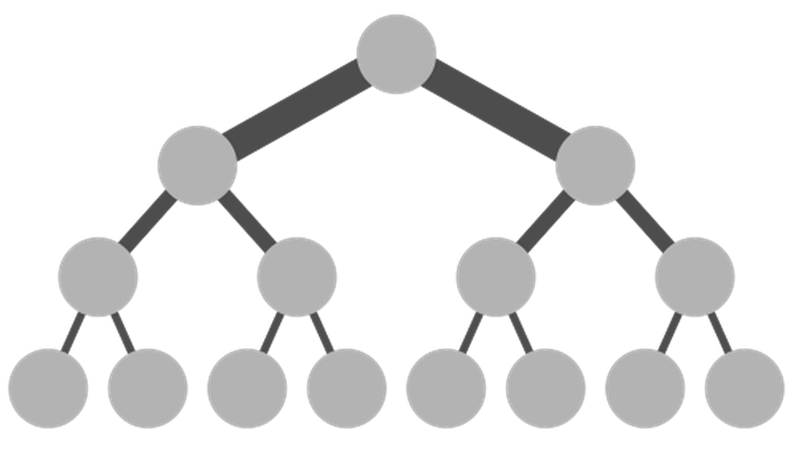
Achieving Full Bisection Bandwidth
O(40x10x100)Gbps
Internet
CR
CR
O(40x10) Gbps
. . .
AR
AR
AR
AR
10Gbps links
S
S
S
S
S
S
. . .
A
A
…
A
A
A
…
A
~ 40 servers/rack
“scale up” approach

Slide 34
Achieving Full Bisection Bandwidth
Problem: “Scaling up” a traditional tree topology is expensive!
requires non-commodity / impractical / link and switch components
Solutions?
Over-subscribe (i.e., provision less than full BBW)
Better topologies

Slide 35
Oversubscription
40G
20G
20G
10G
10G
10G
Need techniques to avoid congesting oversubscribed links!

Slide 36
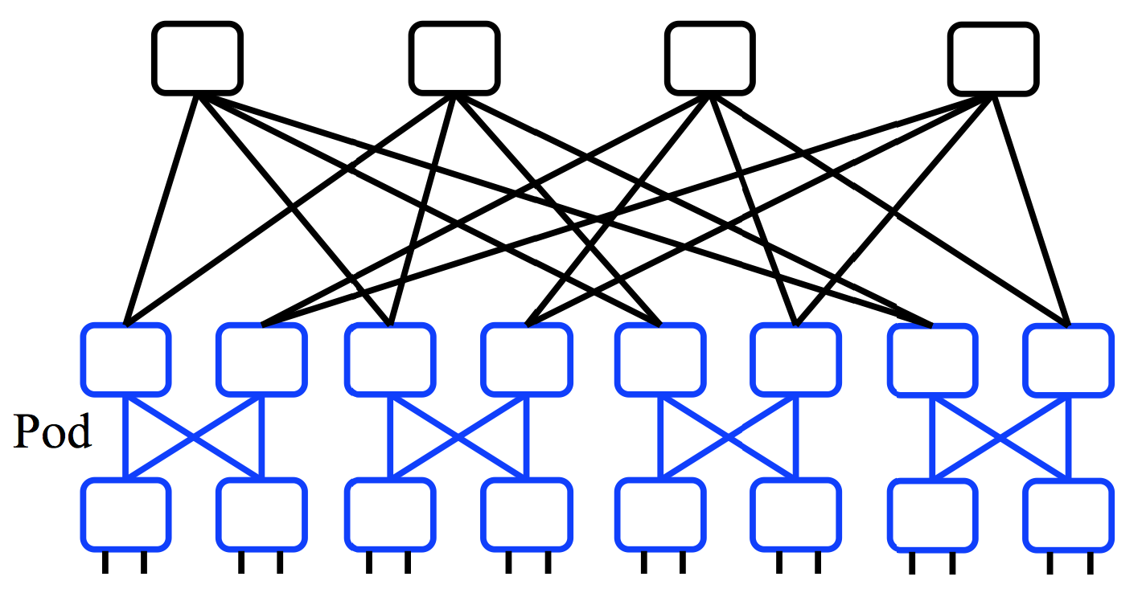
Better topologies?
40G
20G
10G
“scale up” approach
“scale out” approach

Slide 37
Better topologies?
E.g., `Clos’ topology
Multi-stage network
All switches have k ports
k/2 ports up, k/2 down
E.g., with 3 stages, k=48
k³/4 hosts = 27,648 servers
All links have same speed
“scale out” approach

Slide 38
Low Latency
Two (related) issues:
1) Very low RTTs within the DC (approaching 1μsec)
Implications?
BW x delay: 10Gbps x 1μsec = 10000 bits = 2.5 packets
Consider TX 500B @ 10Gbps = 0.4μs per hop = 2μs if a packet traverses 5 hops and waits behind one packet at every hop
What does this mean for buffering and switch design?
What does this mean for congestion control?

Slide 39
Low Latency
Two (related) issues:
Very low RTTs within the DC (approaching 1μsec)
Applications want low latency
predictable / guaranteed bounds on flow completion time, including the worst-case! (recall: `best effort’ vs. `guaranteed service’ debates)
How is still an open question

Slide 40
What’s different about DC networks?
Characteristics
Huge scale
~20,000 switches/routers
contrast: AT&T ISP ~500 routers

Slide 41
What’s different about DC networks?
Characteristics
Huge scale
Limited geographic scope
High bandwidth: 10/40/100G (Contrast: DSL/WiFi)
Very low RTT: 1-10s μsecs. (Contrast: 100s msecs)

Slide 42
What’s different about DC networks?
Characteristics
Huge scale
Limited geographic scope
Limited heterogeneity
link speeds, technologies, latencies, …

Slide 43
What’s different about DC networks?
Characteristics
Huge scale
Limited geographic scope
Limited heterogeneity
Regular/planned topologies (e.g., trees)
Contrast: ad-hoc evolution of wide-area topologies

Slide 44
What’s different about DC networks?
Goals
Extreme bisection bandwidth requirements
recall: all that east-west traffic
target: any server can communicate at its full link speed

Slide 45
What’s different about DC networks?
Goals
Extreme bisection bandwidth requirements
Extreme latency requirements
real money on the line
current target: 1μs RTTs

Slide 46
What’s different about DC networks?
Goals
Extreme bisection bandwidth requirements
Extreme latency requirements
Predictable, deterministic performance
“your packet will reach in Xms, or not at all”
“your VM will always see at least YGbps throughput”
How is still an open question

Slide 47
What’s different about DC networks?
Goals
Extreme bisection bandwidth requirements
Extreme latency requirements
Predictable, deterministic performance
Differentiating between tenants is key
e.g., “No traffic between VMs of tenant A and tenant B”
“Tenant X cannot consume more than XGbps”
“Tenant Y’s traffic is low priority”
SDN

Slide 48
What’s different about DC networks?
Goals
Extreme bisection bandwidth requirements
Extreme latency requirements
Predictable, deterministic performance
Differentiating between tenants is key
Scalability (of course)

Slide 49
What’s different about DC networks?
Goals
Extreme bisection bandwidth requirements
Extreme latency requirements
Predictable, deterministic performance
Differentiating between tenants is key
Scalability (of course)
Cost/efficiency
focus on commodity solutions, ease of management

Slide 50
What’s different about DC networks?
New degrees of (design) freedom
Single administrative domain
Can deviate from standards, invent your own, etc.
“Green field” deployment is still feasible

Slide 51
What’s different about DC networks?
New degrees of (design) freedom
Single administrative domain
Control over network and endpoint(s)
can change (say) addressing, congestion control, etc.
can add mechanisms for security/policy/etc. at the endpoints (typically in the hypervisor)

Slide 52
What’s different about DC networks?
New degrees of (design) freedom
Single administrative domain
Control over network and endpoint(s)
Control over the placement of traffic source/sink
e.g., map-reduce scheduler chooses where tasks run
Can control what traffic crosses which links

Slide 53
Summary
Recap: datacenters
new characteristics and goals
some liberating, some constraining
scalability is the baseline requirement
more emphasis on performance
less emphasis on heterogeneity
less emphasis on interoperability
Notes:
-- incast?
-- one big switch abstraction…

Slide 54
What you need to know
Characteristics of a datacenter environment
goals, constraints, workloads, etc.
How and why DC networks are different (vs. WAN)
e.g., latency, geo, autonomy, …
How traditional solutions fare in this environment
E.g., IP, Ethernet, TCP, DHCP, ARP
Specific design approaches

Slide 55
Recap:
Key requirements
High “bisection bandwidth”
Low latency, even in the worst-case
Large scale
Low cost

Slide 56
E.g., “Fat Tree” Topology [Sigcomm’08]
Notes:
Few things to notice:
3 stages (can think of as edge / aggregation / core)
All switches have same number of ports (=4) [hence k^3/4=16 end hosts]
All links have same speed
Many paths

Slide 57
Next: Questions
L2/L3 design:
addressing / routing / forwarding in the Fat-Tree
L4 design:
Transport protocol design (w/ Fat-Tree)

Slide 58
Using multiple paths well

Slide 59
Questions for today
L2/L3 design:
addressing / routing / forwarding in the Fat-Tree
Goals:
Routing protocol must expose all available paths
Forwarding must spread traffic evenly over all paths

Slide 60
Extend DV / LS ?
Routing
Distance-Vector: Remember all next-hops that advertise equal cost to a destination
Link-State: Extend Dijkstra’s to compute all equal cost shortest paths to each destination
Forwarding: how to spread traffic across next hops?

Slide 61
Forwarding
to D
to D
to D
from A (to D)
from B (to D)
from C (to D)
Per-packet load balancing

Slide 62
Forwarding
to D
to D
to D
from A (to D)
from B (to D)
from C (to D)
Per-packet load balancing
+ traffic well spread (even w/ elephant flows)
− Interacts badly w/ TCP

Slide 63
TCP w/ per-packet load balancing
Consider:
sender sends seq#: 1,2,3,4,5
receiver receives: 5,4,3,2,1
sender will enter fast retx, reduce CWND, retx #1, …
repeatedly!
Also: one RTT and timeout estimator for multiple paths
Also: CWND halved when a packet is dropped on any path
Multipath TCP (MP-TCP) is an ongoing effort to extend TCP to coexist with multipath routing
Value beyond datacenters (e.g., spread traffic across wifi and 4G access)

Slide 64
Forwarding
to D
to D
to D
from A (to D)
from B (to D)
from C (to D)
Per-flow load balancing (ECMP, “Equal Cost Multi Path”)
E.g., based on HASH(source-addr, dst-addr, source-port, dst-port)

Slide 65
Forwarding
to D
to D
to D
from A (to D)
from B (to D)
from C (to D)
Per-flow load balancing (ECMP, “Equal Cost Multi Path”)
E.g., based on HASH(source-addr, dst-addr, source-port, dst-port)
Pro: a flow follows a single path (→ TCP is happy)
Con: non optimal load-balancing; elephants are a problem

Slide 66
Extend DV / LS ?
How:
Simple extensions to DV/LS
ECMP for load balancing
Benefits
+ Simple; reuses existing solutions
Problem: scales poorly
With N destinations, O(N) routing entries and messages
N now in the millions!

Slide 67
Design a scalable routing solution
Design for this specific topology
Take 5 minutes, then tell me:
#routing entries per switch your solution needs
many solutions possible; remember: you’re now free from backward compatibility (can redesign IP, routing algorithms, switch designs, etc.)

Slide 68
Solution 1: Topology-aware addressing
10.0.*.*
10.1.*.*
10.2.*.*
10.3.*.*
Notes:
Few things to notice:
3 stages (can think of as edge / aggregation / core)
All switches have same number of ports (=4) [hence k^3/4=16 end hosts]
All links have same speed
Many paths

Slide 69
Solution 1: Topology-aware addressing
10.0.0.*
10.0.1.*
10.1.0.*
10.1.1.*
10.2.0.*
10.2.1.*
10.3.0.*
10.3.1.*
Notes:
Few things to notice:
3 stages (can think of as edge / aggregation / core)
All switches have same number of ports (=4) [hence k^3/4=16 end hosts]
All links have same speed
Many paths

Slide 70
Solution 1: Topology-aware addressing
10.0.0.1
10.2.0.1
10.0.0.0
10.2.0.0
10.3.0.1
10.3.1.1
10.0.1.1
10.1.0.1
10.2.1.1
10.3.0.0
10.0.1.0
10.1.0.0
10.1.1.1
10.2.1.0
10.3.1.0
10.1.1.0
Notes:
Few things to notice:
3 stages (can think of as edge / aggregation / core)
All switches have same number of ports (=4) [hence k^3/4=16 end hosts]
All links have same speed
Many paths

Slide 71
Solution 1: Topology-aware addressing
10.0.*.* → 1
10.1.*.* → 2
10.2.*.* → 3
10.3.*.* → 4
4
1
2
3
10.0.0.1
10.2.0.1
10.0.0.0
10.2.0.0
10.3.0.1
10.3.1.1
10.0.1.1
10.1.0.1
10.2.1.1
10.3.0.0
10.0.1.0
10.1.0.0
10.1.1.1
10.2.1.0
10.3.1.0
10.1.1.0
Notes:
Few things to notice:
3 stages (can think of as edge / aggregation / core)
All switches have same number of ports (=4) [hence k^3/4=16 end hosts]
All links have same speed
Many paths

Slide 72
Solution 1: Topology-aware addressing
10.0.0.* → 1
10.0.1.* → 2
*.*.*.* → 3, 4
4
3
1
2
10.0.0.1
10.2.0.1
10.0.0.0
10.2.0.0
10.3.0.1
10.3.1.1
10.0.1.1
10.1.0.1
10.2.1.1
10.3.0.0
10.0.1.0
10.1.0.0
10.1.1.1
10.2.1.0
10.3.1.0
10.1.1.0
Notes:
Few things to notice:
3 stages (can think of as edge / aggregation / core)
All switches have same number of ports (=4) [hence k^3/4=16 end hosts]
All links have same speed
Many paths

Slide 73
Solution 1: Topology-aware addressing
10.0.0.* → 1
10.0.1.* → 2
*.*.*.0 → 3
*.*.*.1 → 4
4
3
1
2
10.0.0.1
10.2.0.1
10.0.0.0
10.2.0.0
10.3.0.1
10.3.1.1
10.0.1.1
10.1.0.1
10.2.1.1
10.3.0.0
10.0.1.0
10.1.0.0
10.1.1.1
10.2.1.0
10.3.1.0
10.1.1.0
Notes:
Few things to notice:
3 stages (can think of as edge / aggregation / core)
All switches have same number of ports (=4) [hence k^3/4=16 end hosts]
All links have same speed
Many paths

Slide 74
Solution 1: Topology-aware addressing
10.0.0.0 → 1
10.0.0.1 → 2
*.*.*.0 → 3
*.*.*.1 → 4
4
3
1
2
10.0.0.1
10.2.0.1
10.0.0.0
10.2.0.0
10.3.0.1
10.3.1.1
10.0.1.1
10.1.0.1
10.2.1.1
10.3.0.0
10.0.1.0
10.1.0.0
10.1.1.1
10.2.1.0
10.3.1.0
10.1.1.0
Notes:
Few things to notice:
3 stages (can think of as edge / aggregation / core)
All switches have same number of ports (=4) [hence k^3/4=16 end hosts]
All links have same speed
Many paths

Slide 75
Solution 1: Topology-aware addressing
Idea: addresses embed location in regular topology
Maximum #entries/switch: k ( = 4 in example)
Constant, independent of #destinations!
No route computation / messages / protocols
Topology is “hard coded”
(but still need localized link failure detection)
Problems?
VM migration: ideally, VM keeps its IP address when it moves
Vulnerable to misconfiguration (in topology or addresses)
Notes:
Few things to notice:
3 stages (can think of as edge / aggregation / core)
All switches have same number of ports (=4) [hence k^3/4=16 end hosts]
All links have same speed
Many paths

Slide 76
Solution 2: Centralize + Source Routes
Centralized “controller” server knows topology and computes routes
Controller hands server all paths to each destination
O(#destinations) state per server
But server memory cheap (e.g., 1M routes x 100B/route=100MB)
Server inserts entire path vector into packet header (“source routing”)
E.g., header=[dst=D | index=0 | path={S5,S1,S2,S9}]
Switch forwards based on packet header
index++; next-hop = path[index]
Notes:
Few things to notice:
3 stages (can think of as edge / aggregation / core)
All switches have same number of ports (=4) [hence k^3/4=16 end hosts]
All links have same speed
Many paths

Slide 77
Solution 2: Centralize + Source Routes
#entries per switch?
None!
#routing messages?
akin to a broadcast from controller to all servers
Pro:
switches very simple and scalable
flexibility: end-points (hence apps) control route selection
Cons:
scalability / robustness of controller (SDN addresses this)
Clean-slate design of everything
Notes:
Few things to notice:
3 stages (can think of as edge / aggregation / core)
All switches have same number of ports (=4) [hence k^3/4=16 end hosts]
All links have same speed
Many paths

Slide 78
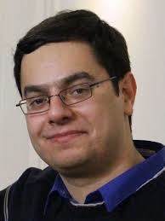
Questions for today
L2/L3 design:
addressing / routing / forwarding in the Fat-Tree
L4 design:
Transport protocol design (w/ Fat-Tree)
Many slides courtesy of Mohammad Alizadeh, Stanford University

Slide 79


Workloads
Partition/Aggregate
(Query)
Short messages [50KB-1MB]
(Coordination, Control state)
Large flows [1MB-50MB]
(Data update)
Delay-sensitive
Delay-sensitive
Throughput-sensitive
Slide from Mohammad Alizadeh, Stanford University
Notes:
Replace PDF

Slide 80
Tension Between Requirements
High Throughput
vs.
Low Latency
Deep queues at switches:
Queuing delays
increase latency
Shallow queues at switches:
Bad for bursts &
throughput
DCTCP
Objective:
Low Queue Occupancy & High Throughput
Slide from Mohammad Alizadeh, Stanford University
Notes:
Deep Buffers – bad for latency
Shallow Buffers – bad for bursts & throughput
Reduce RTO_{min} – no good for latency
AQM – Difficult to tune, not fast enough for incast-style micro-bursts, lose throughput in low stat-mux

Slide 81
Data Center TCP (DC-TCP)
Proposal from Microsoft Research, 2010
Incremental fixes to TCP for DC environments
Deployed in Microsoft datacenters (~rumor)
Leverages Explicit Congestion Notification (ECN)

Slide 82
Explicit Congestion Notification (ECN)
Defined in RFC 3168 using ToS/DSCP bits in the IP header
Single bit in packet header; set by congested routers
If data packet has bit set, then ACK has ECN bit set
Routers typically set ECN bit based on average queue length
Congestion semantics exactly like that of drop
I.e., sender reacts as though it saw a drop

Slide 83

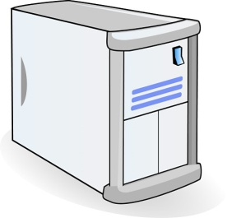
Review: The TCP/ECN Control Loop
Sender 1
ECN = Explicit Congestion Notification
ECN Mark (1 bit)
Receiver
Sender 2
Slide from Mohammad Alizadeh, Stanford University
Notes:
DCTCP is based on the existing Explicit Congestion Notification framework in TCP.

Slide 84
DC-TCP: key ideas
React early and quickly: use ECN
React in proportion to the extent of congestion, not its presence
ECN Marks | TCP | DCTCP
1 0 1 1 1 1 0 1 1 1 | Cut window by 50% | Cut window by 40%
0 0 0 0 0 0 0 0 0 1 | Cut window by 50% | Cut window by 5%
Slide from Mohammad Alizadeh, Stanford University

Slide 85
At the switch
If Queue Length > K (note: queue length is instantaneous, not average)
Set ECN bit in packet
K
Mark
Don’t
Mark
Slide from Mohammad Alizadeh, Stanford University

Slide 86
At the sender
Maintain running average of the fraction of packets marked (α).
Window adapts based on α:
α equal to 1 (high congestion): (same as TCP!)
Slide from Mohammad Alizadeh, Stanford University

Slide 87
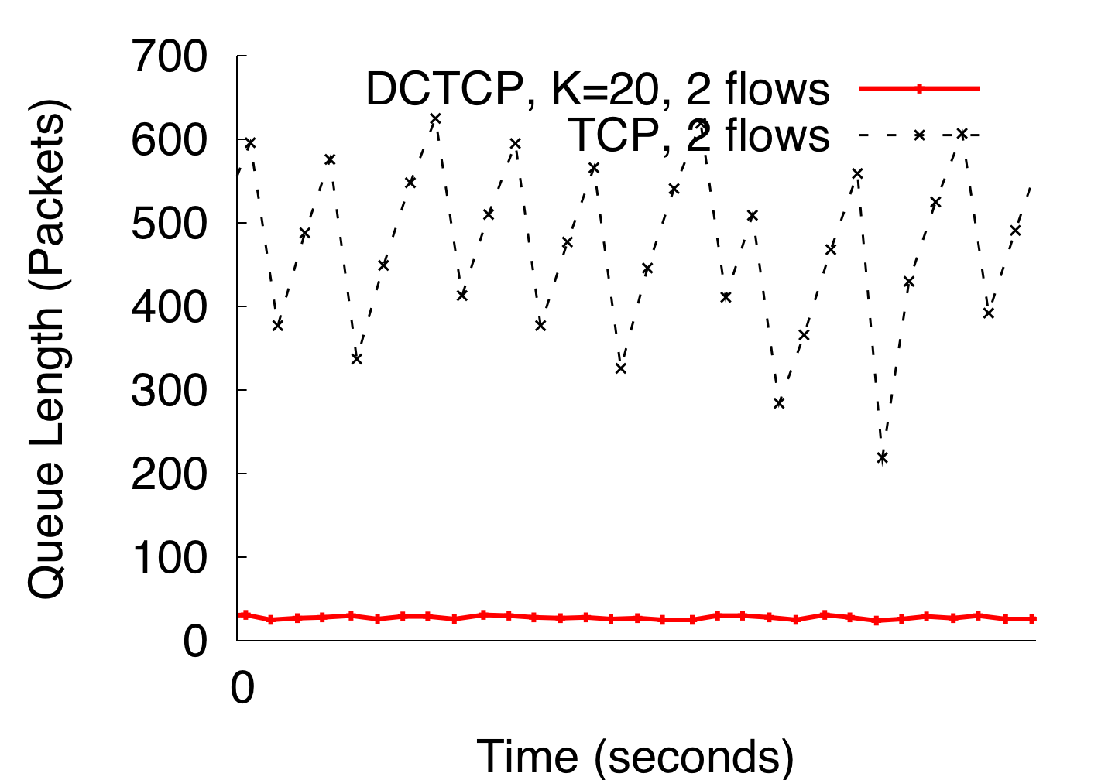
DCTCP in Action
(Kbytes)
Setup: Win 7, Broadcom 1Gbps Switch
Scenario: 2 long-lived flows, K = 30KB
Slide from Mohammad Alizadeh, Stanford University
Notes:
Not ns2.

Slide 88
DC-TCP: why it works
React early and quickly: use ECN
→ Avoid large buildup in queues → lower latency
React in proportion to the extent of congestion, not its presence
Maintain high throughput by not over-reacting to congestion
Reduces variance in sending rates, lowering queue buildups
Slide from Mohammad Alizadeh, Stanford University

Slide 89
Data Center TCP (DC-TCP)
Proposal from Microsoft Research, 2010
Incremental fixes to TCP for DC environments
Deployed in Microsoft datacenters (~rumor)
Leverages Explicit Congestion Notification (ECN)
An improvement; but still far from “ideal”

Slide 90
What’s “ideal” ?
What is the best measure of performance for a data center transport protocol?
When the flow is completely transferred?
Latency of each packet in the flow?
Number of packet drops?
Link utilization?
Average queue length at switches?

Slide 91
Flow Completion Time (FCT)
Time from when flow started at the sender, to when all packets in the flow were received at the receiver

Slide 92
FCT with DCTCP
Slide from Mohammad Alizadeh, Stanford University

Slide 93
Recall: “Elephants” and “Mice”
Web search, data mining (Microsoft) [Alizadeh 2010]
<100KB
>10MB
55% of flows
3% of bytes
5% of flows
35% of bytes
Slide from Mohammad Alizadeh, Stanford University

Slide 94
FCT with DCTCP
Problem: the mice are delayed by the elephants
Slide from Mohammad Alizadeh, Stanford University

Slide 95
Solution: use priorities! [pFabric, Sigcomm 2013]
Packets carry a single priority number
priority = remaining flow size (e.g., #bytes un-acked)
Switches
very small queues (e.g., 10 packets)
send highest priority / drop lowest priority packet
Servers
Transmit/retransmit aggressively (at full link rate)
Drop transmission rate only under extreme loss (timeouts)
Slide from Mohammad Alizadeh, Stanford University

Slide 96
FCT
Slide from Mohammad Alizadeh, Stanford University

Slide 97
FCT
Slide from Mohammad Alizadeh, Stanford University

Slide 98
Why does pFabric work?
Consider problem of scheduling N jobs at a single queue/processor
J_{1,} J₂, … , J_{n} with duration T₁, T₂, …T_{n} respectively
“Shortest Job First” (SJF) scheduling minimizes average Job Completion Time
Pick job with minimum T_{i} ; de-queue and run ; repeat
I.e., job that requires minimum runtime has max priority
Solution for a network of queues is NP-hard
Setting priority=remaining flow size is a heuristic to approximate SJF

Slide 99
DIY exercise: why does SJF work?
Consider 4 jobs with duration 1,2,4,8
Compute finish times w/ Round-Robin vs. SJF
Assume scheduler:
Picks best job (as per scheduling policy)
Runs job for one time unit
Update job durations
repeat
Job completion times:
With RR: 1, 5, 10, 15
With SJF: 1, 3, 7, 15

Slide 100
Summary
Learn more:
https://code.facebook.com/posts/360346274145943/introducing-data-center-fabric-the-next-generation-facebook-data-center-network/
Notes:
-- incast?
-- one big switch abstraction…

